Slide 1
Detection Transformers
DETR | Conditional DETR | DAB-DETR | DN-DETR | DINO (DETR)
Denis Shepelev, March 2023 https://github.com/denzist/presentations

Slide 2
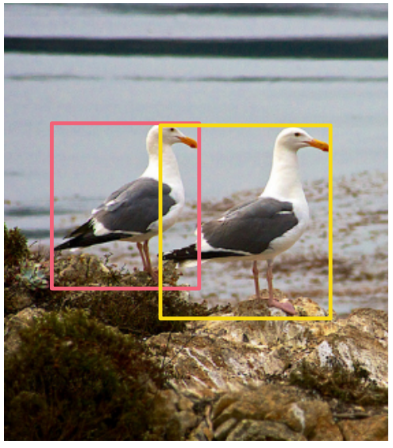
Object detection
For given image detect all objects, i.e. estimate:
objects classes
positions – bounding box (bbox)
This is a set prediction problem

Slide 3
Near-duplicate problem
Previous methods utilizes a large set of anchors to obtain target bboxes, which leads to near-duplicate predictions
To remove duplicates various hand-crafted heuristics are used, for example non-maximum suppression (NMS)
Solution: construct end-to-end solution, that do not rely on hand-crafted blocks and reduces used prior knowledge

Slide 4
Plan
DETR
Conditional DETR
DAB DETR
DN DETR
DINO

Slide 5
DETR
End-to-End Object Detection with Transformers (ECCV, 2020)

Slide 6
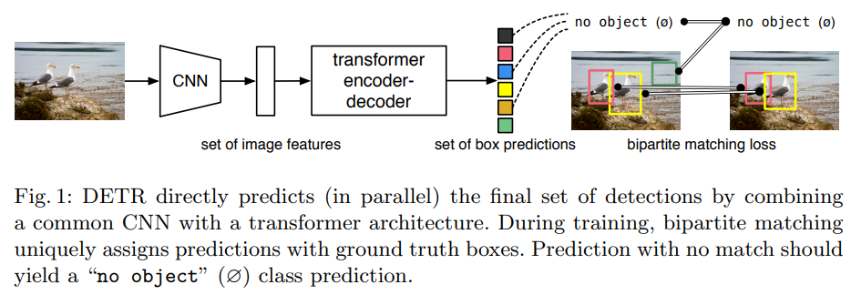
DETR

Slide 7
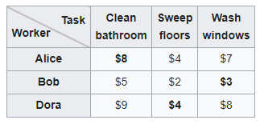
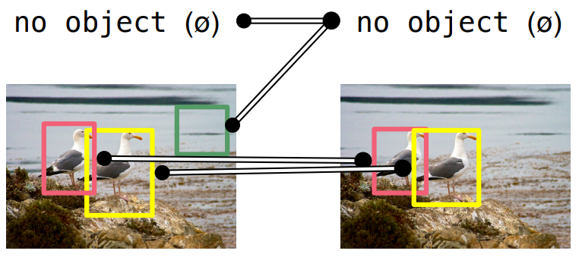
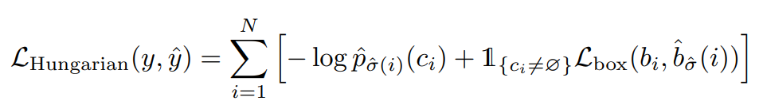
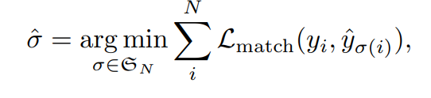

Bipartite matching
Assignment problem example can be solved by Hungarian algorithm
$$=$$

Slide 8
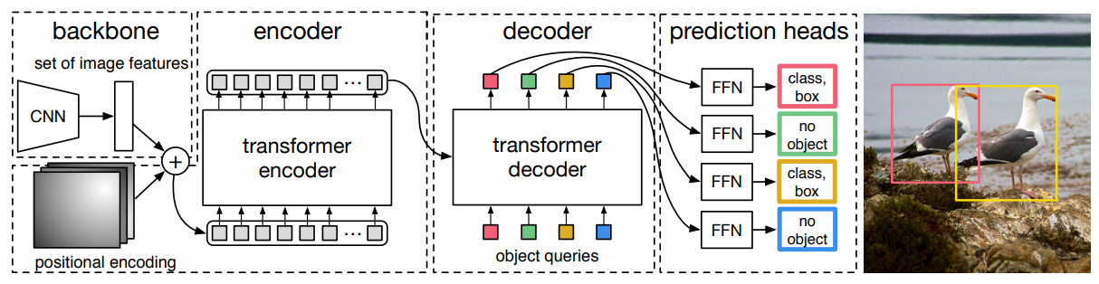
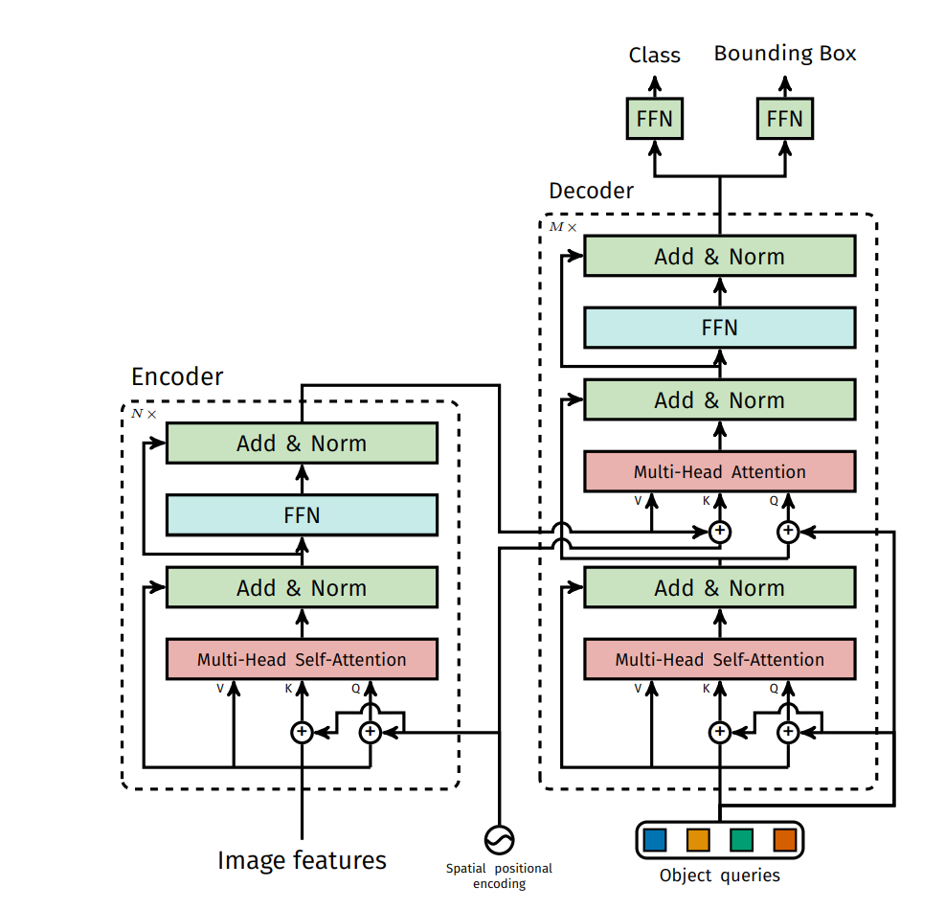
Encoder-Decoder

Slide 9
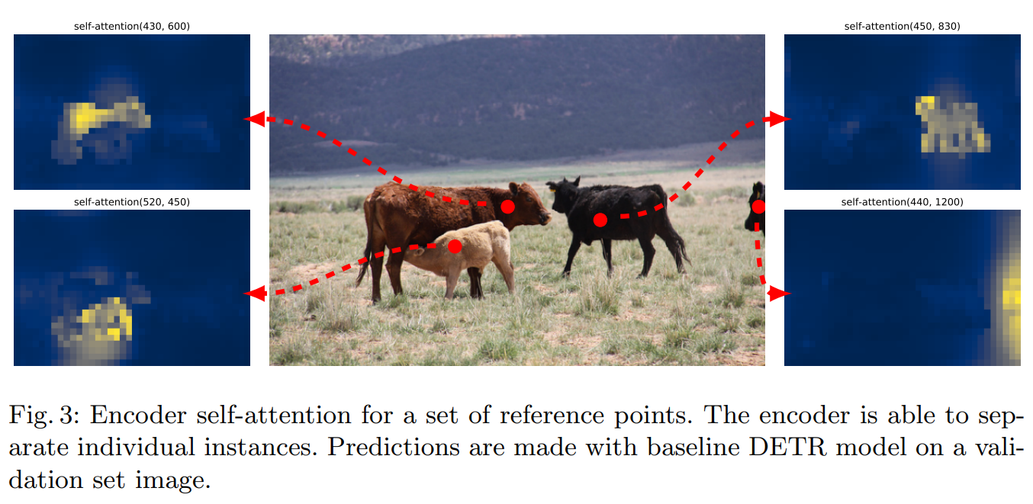
Encoder self-attention

Slide 10
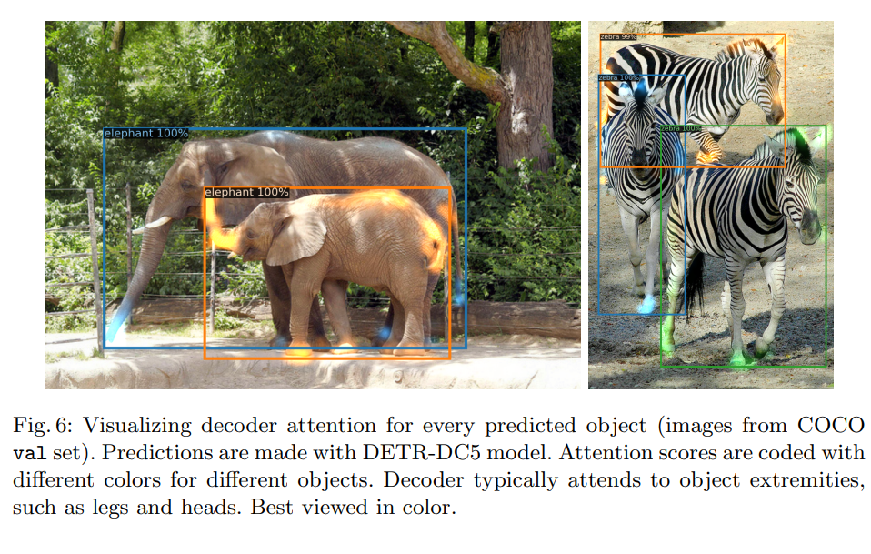
Object queries (learnt positional encodings)

Slide 11
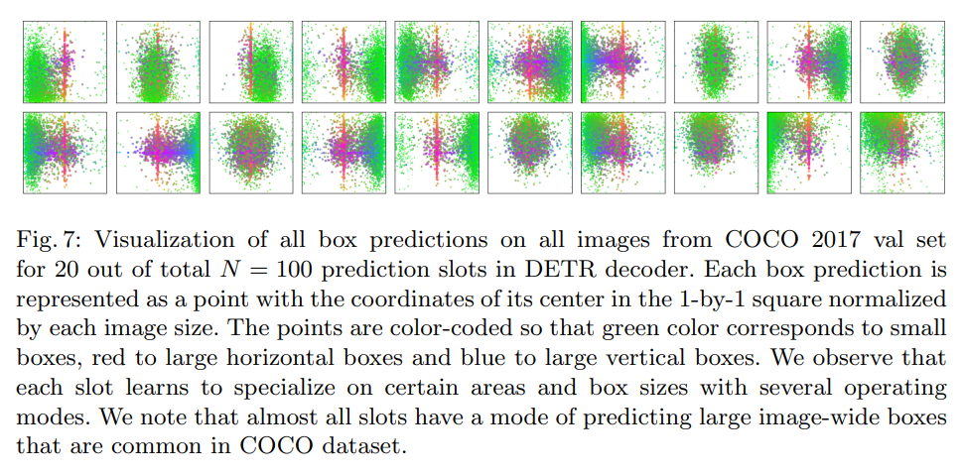
Object queries (learnt positional encodings)

Slide 12
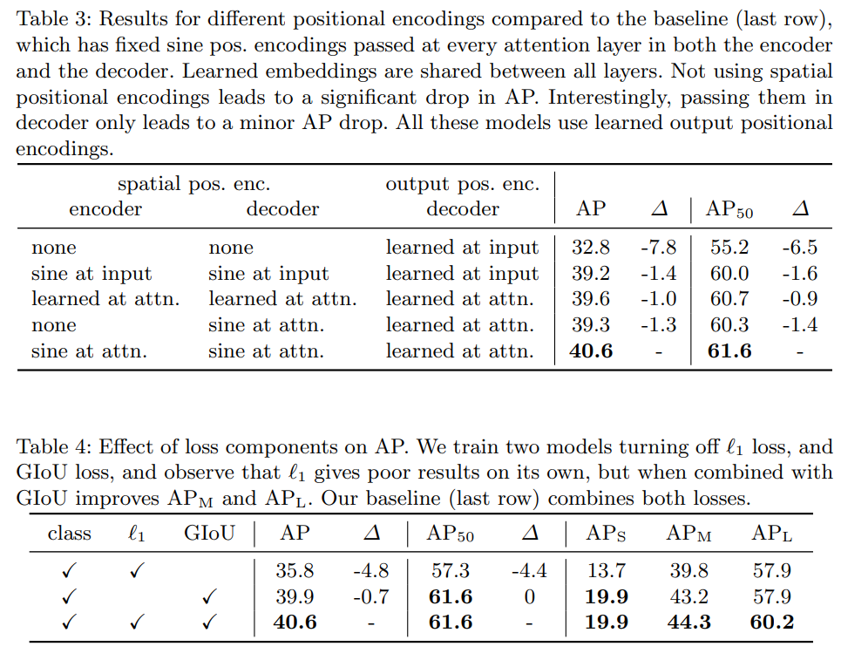
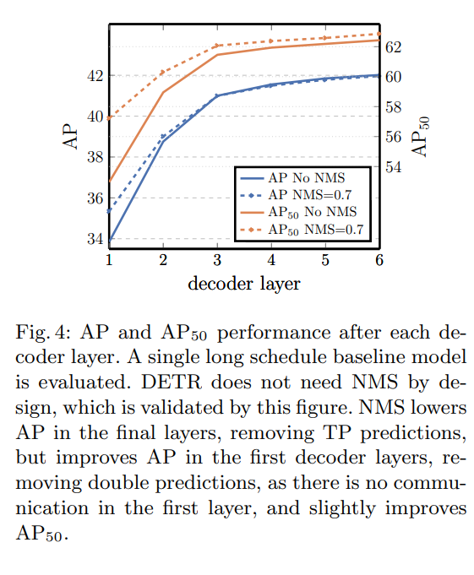
Ablations

Slide 13
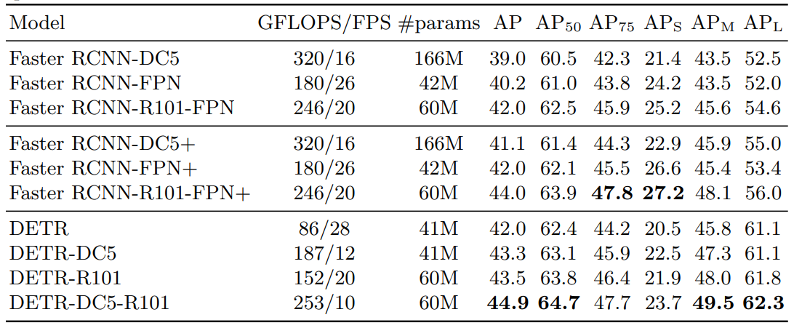
Comparisons to other detectors
Still worse than Faster RCNN on small objects

Slide 14
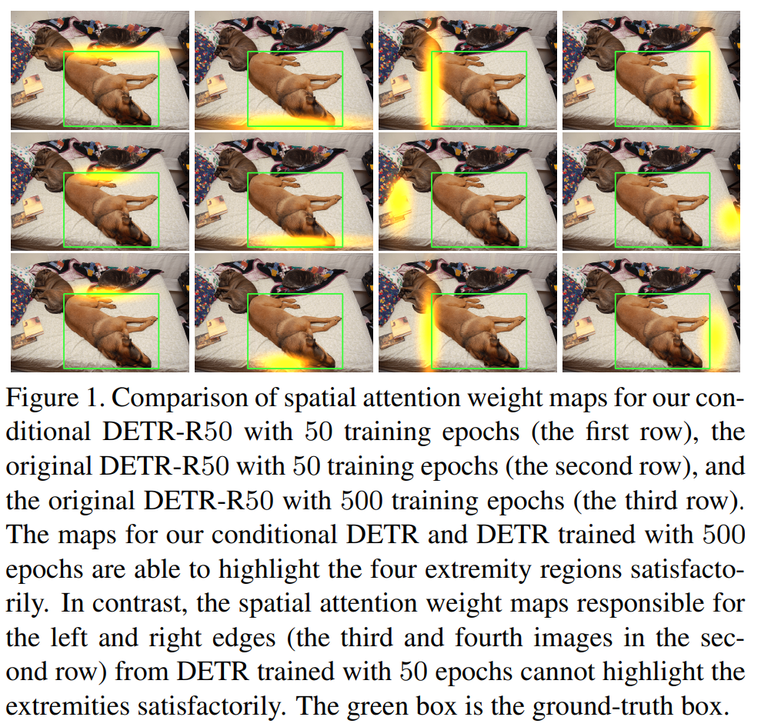
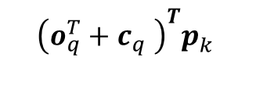
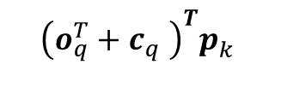
DETR training time is long
Learnt positional encodings are not so good
$${\left(o_{q}^{T}+c_{q}^{}\right)}^{T}p_{k}^{}$$
$${\left(o_{q}^{T}+c_{q}^{}\right)}^{T}p_{k}^{}$$
Attention map after training DETR for 50 epochs (first row) and 500 epochs (second row)

Slide 15
Conditional DETR
Conditional DETR for Fast Training Convergence (ICCV 2021)

Slide 16
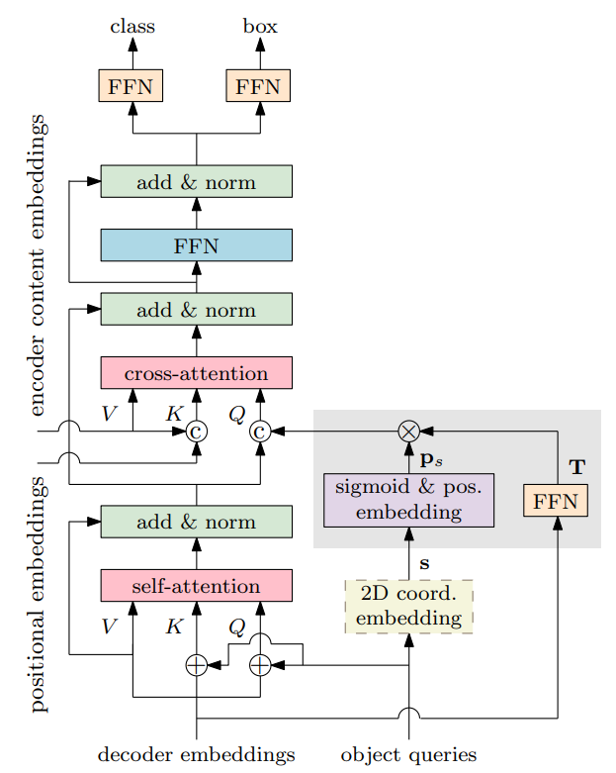
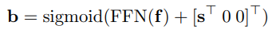
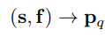
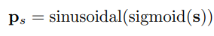
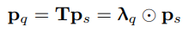
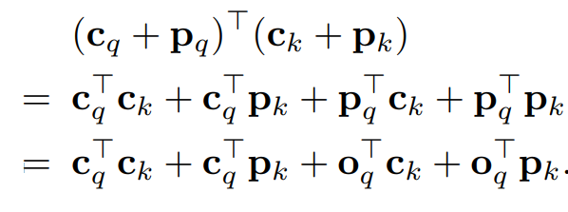
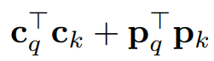

Conditional DETR
Estimate bboxes as:
In DETR $s=0$
In Conditional DETR $s$ is learnt
DETR attention estimation:
Conditional DETR attention estimation:

Slide 17
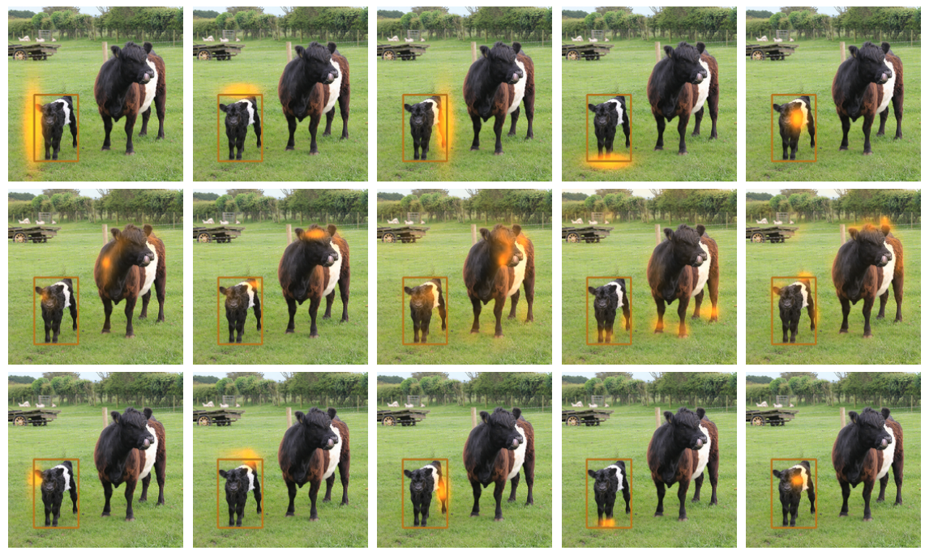
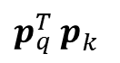
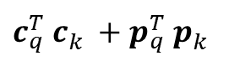
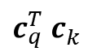
Conditional object queries
$p_{q}^{T}$ $p_{k}^{}$
$c_{q}^{T}$ $c_{k}^{}$
$c_{q}^{T}$ $c_{k}^{}+p_{q}^{T} p_{k}^{}$

Slide 18
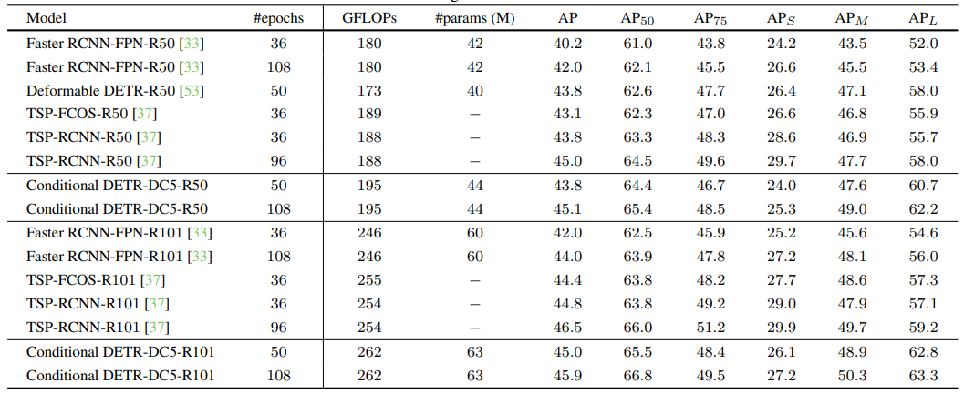
Comparison

Slide 19
DAB DETR
DAB-DETR: Dynamic Anchor Boxes are Better Queries for DETR (ICLR 2022)

Slide 20
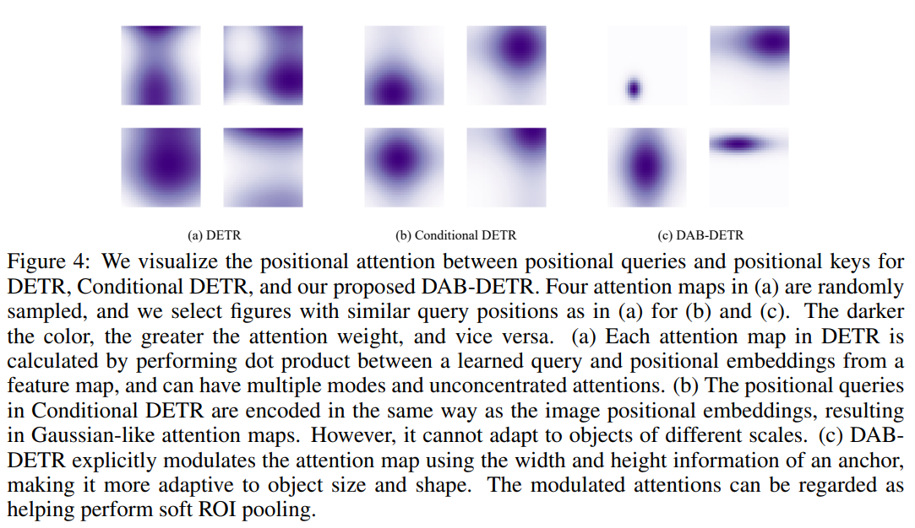
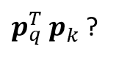
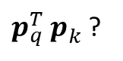
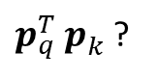
Object queries vs positional encodings
$p_{q}^{T}$ $p_{k}^{}$?
$p_{q}^{T}$ $p_{k}^{}$?
$p_{q}^{T}$ $p_{k}^{}$?

Slide 21
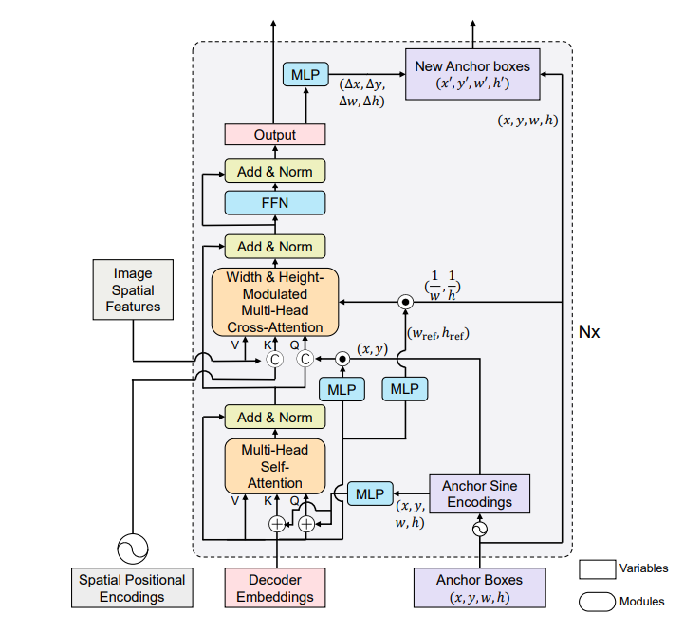
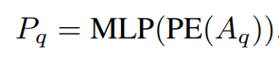
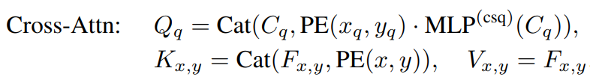
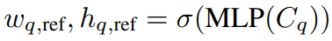
DAB-DETR

Slide 22
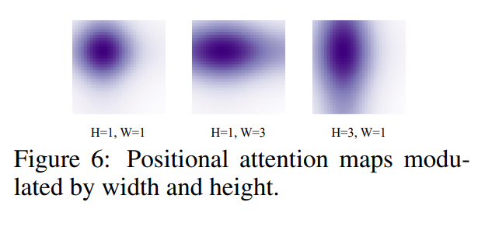
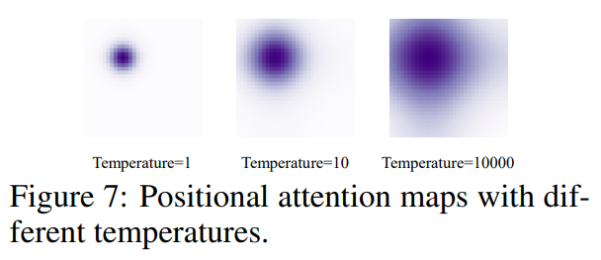
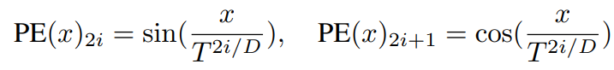
Modulation and temperature tuning

Slide 23
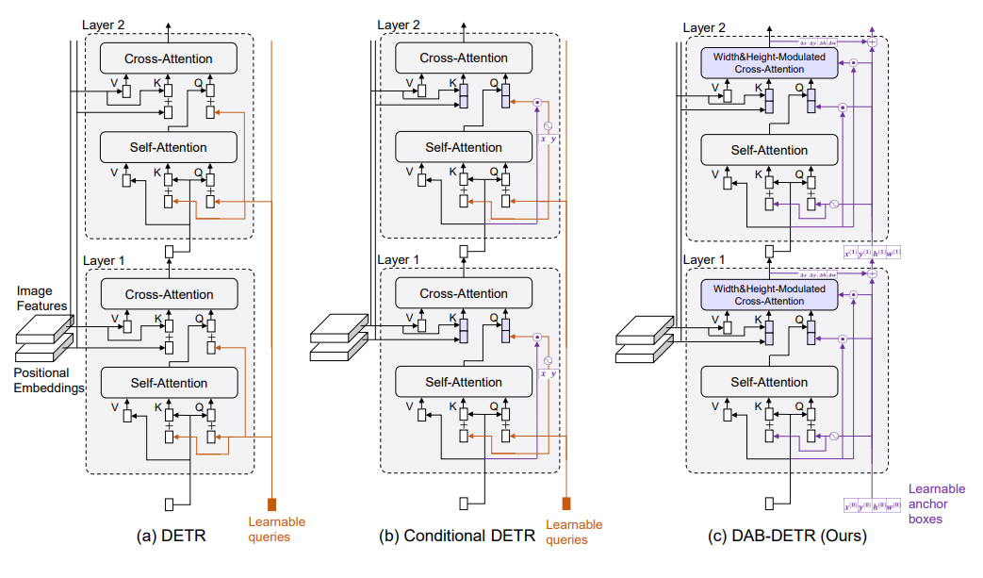
Architecture comparison

Slide 24
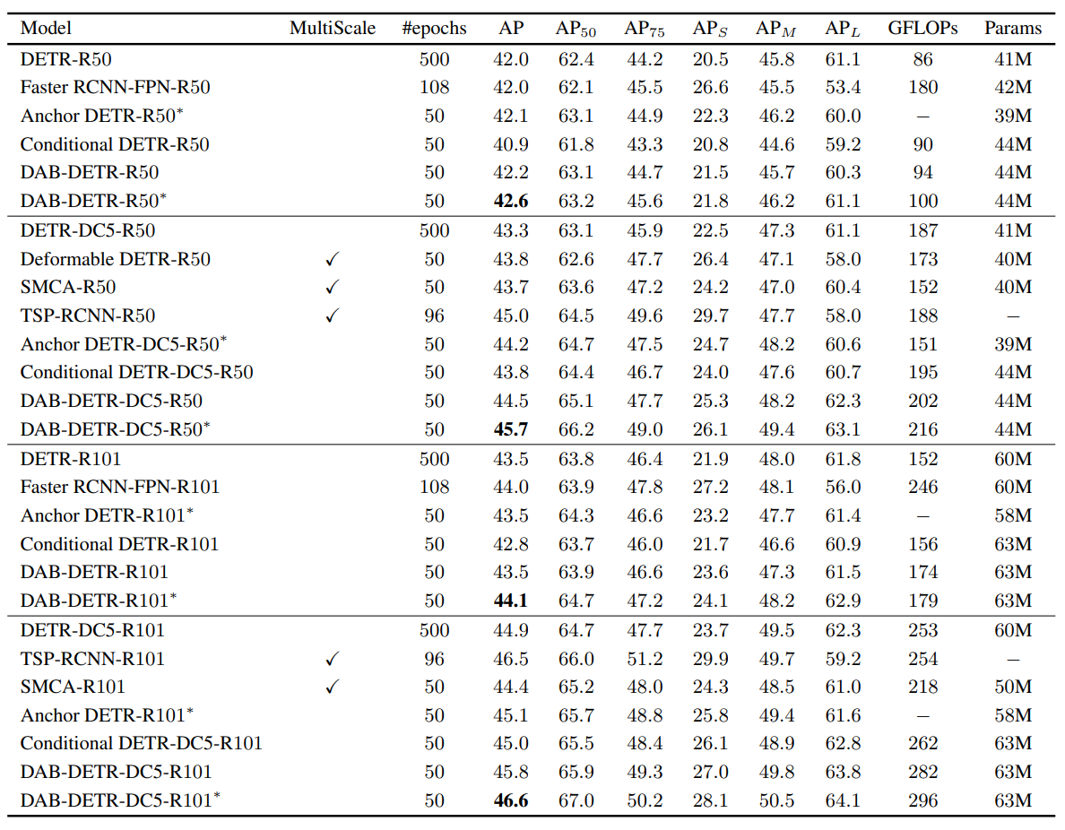
Comparison

Slide 25
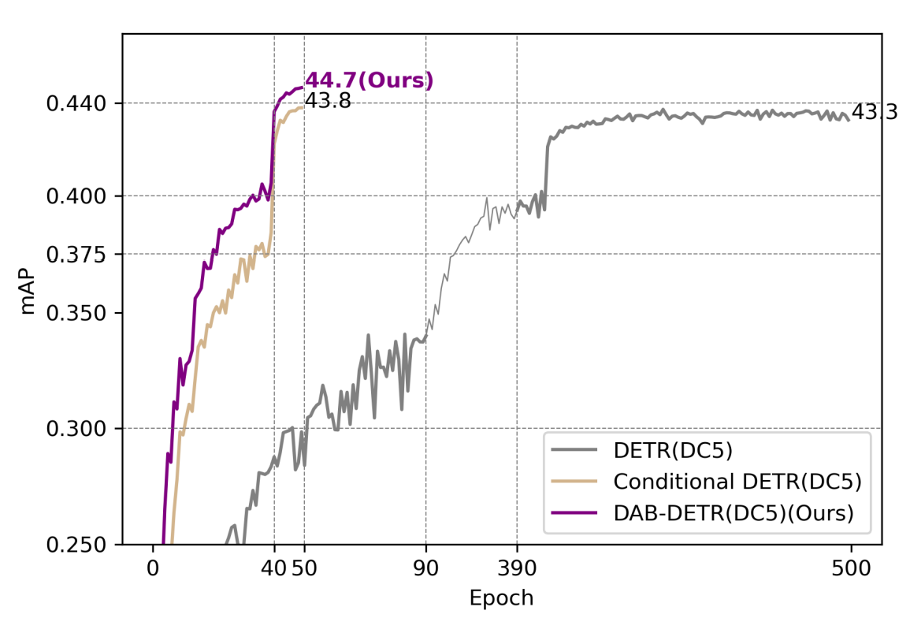
Convergence

Slide 26
DN DETR
DN-DETR: Accelerate DETR Training by Introducing Query DeNoising (CVPR 2022)

Slide 27
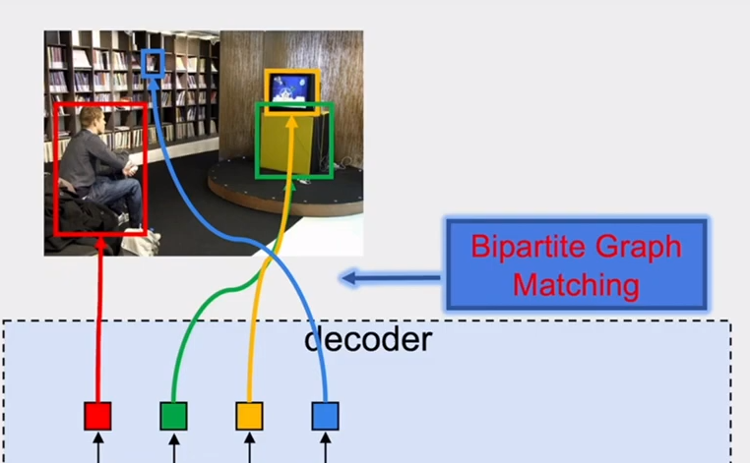
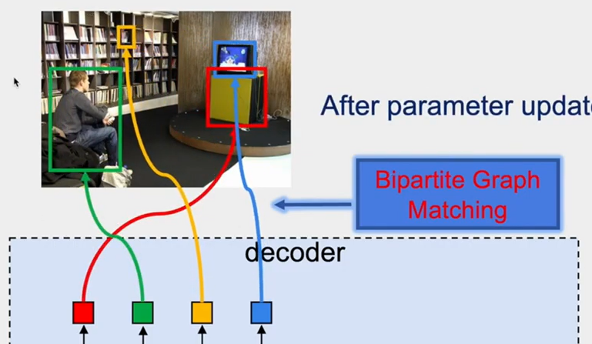
Bipartite matching instability (1)
Before parameters update
After parameters update

Slide 28
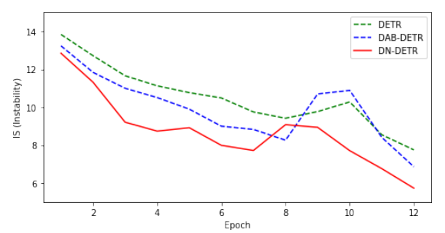
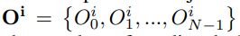
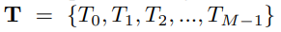
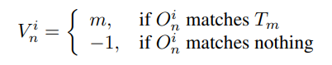
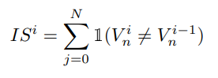
Bipartite matching instability (2)
Bipartite matching is unstable and might lead to slow convergence!

Slide 29


Denoising (DN) training
Solution: solve denoising task additionally to matching

Slide 30

DN-DETR

Slide 31

Comparison

Slide 32

Convergence

Slide 33
DINO
DINO: DETR with Improved DeNoising Anchor Boxes for End-to-End Object Detection (ICLR 2023)

Slide 34

DINO

Slide 35

Contrastive denoising (CDN) training

Slide 36


CDN reduces duplicates
DN
CDN

Slide 37

Mixed query selection

Slide 38


Comparison

Slide 39

Convergence

Slide 40

Ablation

Slide 41
Conclusions
DETR model converges too slowly
Main reasons:
Inexplicit learnable positional queries
Bipartite matching
Solutions:
For learnable positional queries use bboxes
In training learn additional tasks – e.g. CDN

